Slide 1

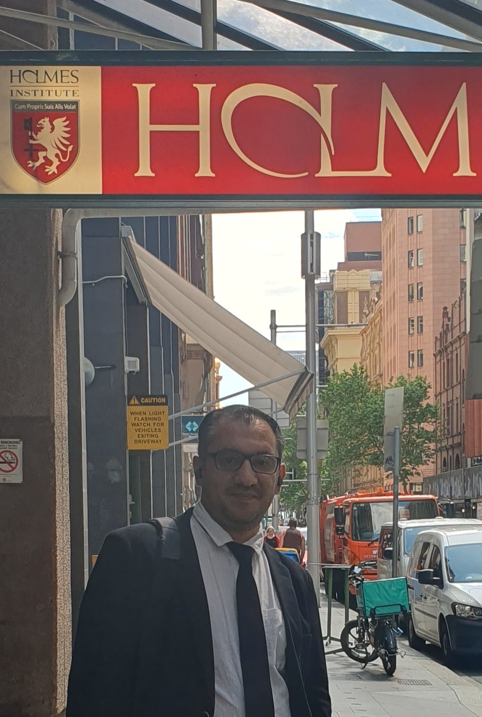
HI6040 (Artificial Intelligence and Machine Learning)
Dr. Farshid Keivanian
Tutorial Week 7

Slide 2
Outline
Group Class Facilitation for HI6040-S1-T2.2025 (Sydney Campus)
What Students Should Do in Week 7
Example 1 – ROC Curve and AUC
Example 1 – Result Analysis
Example 2 – Overfitting Check (Decision Tree)
Activity 1: Change the Classifier
Activity 2: Change the Train-Test Split Ratio
Example 2 – Result Analysis
Example 2 – Student Key Takeaways
Activity 3: Compare Train vs Test Accuracy
Activity 4: Use ROC Curve & AUC Instead of Accuracy
Simple Discussion Questions for Week 7
Simple Discussion Questions for Week 7
Suggested Titles for Slides

Slide 3
Group Class Facilitation for HI6040-S1-T2.2025 (Sydney Campus)
For the Group Class Facilitation assessment (worth 30%), your group must select a topic and email it to me for approval.
In addition, each group must book a time slot for your presentation session. Please use the following link to book your slot:
Presentation Schedule for HI6040-2025 (Sydney S1).xlsx

Slide 4
Group Class Facilitation for HI6040-S1-T2.2025 (Sydney Campus)
Important guidelines:
Each group must choose a topic (from the proposed AI/ML areas) and obtain approval by email.
Time slots are allocated on a first-come, first-served basis.
Enter your group’s details directly into the booking sheet.
Each group presents only once, in their allocated week (Weeks 5–11).
Each student is expected to present for about 5 minutes.
Your slides must be submitted on Blackboard before your facilitation session (one submission per group).
After booking, please send me a confirmation email.

Slide 5
What Students Should Do in Week 7
Topic focus: Supervised Learning – Evaluation & Model Improvement
Task: Compare models, but focus on how well they perform and how to interpret results, not just the accuracy.
Output: One PowerPoint slide per group with:
A confusion matrix and at least one other metric (precision, recall, F1, ROC/AUC).
Short reflection: Which model performs better? Why?
A practical business example: What does this mean for a company or hospital?

Slide 6
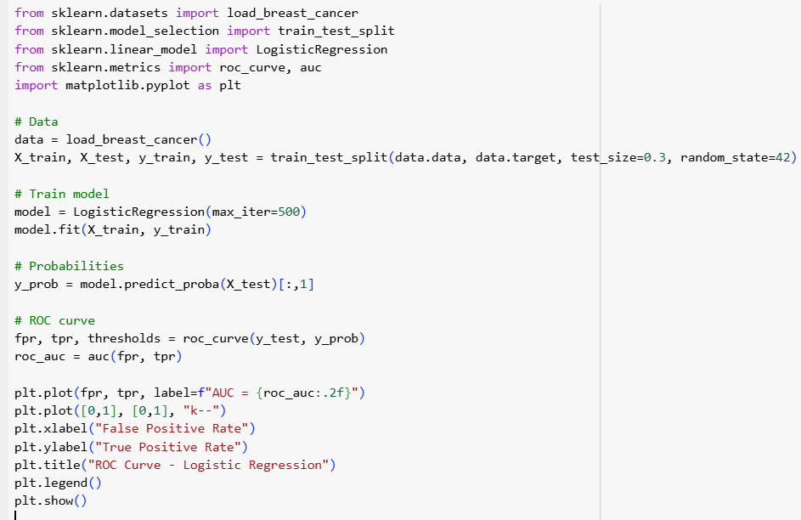
Example 1 – ROC Curve and AUC

Slide 7
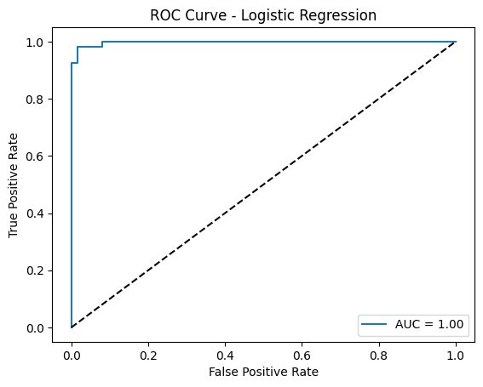
Example 1 – Result Analysis
The ROC curve shows how well our Logistic Regression model separates the two classes: malignant (cancer) and benign (not cancer).
The blue curve is almost perfect and hugs the top-left corner, meaning the model is excellent at distinguishing between the two.
The AUC (Area Under Curve) = 1.00, which is the best possible score. In simple words: our model is extremely accurate in predicting whether a tumor is malignant or benign.

Slide 8

Activity 1: Change the Classifier
Task: Replace LogisticRegression with a DecisionTreeClassifier and compare the ROC curve.
from sklearn.tree import DecisionTreeClassifier
# Train model
model = DecisionTreeClassifier(random_state=42)
model.fit(X_train, y_train)
# Probabilities
y_prob = model.predict_proba(X_test)[:,1]
Student Questions:
Plot the ROC curve and calculate the AUC.
Compare the shape of the ROC curve and the AUC score with Example 1 (Logistic Regression).
Which model performed better on this dataset? Why?

Slide 9
Activity 2: Change the Train-Test Split Ratio
Task: Modify the train_test_split proportion and see the effect.
Example:
X_train, X_test, y_train, y_test = train_test_split(
data.data, data.target, test_size=0.5, random_state=42)
Student Questions:
Re-plot the ROC curve with the new split.
Did the AUC score change compared to Example 1 (70% train / 30% test)?
Why does changing the amount of training vs. testing data affect model performance?

Slide 10
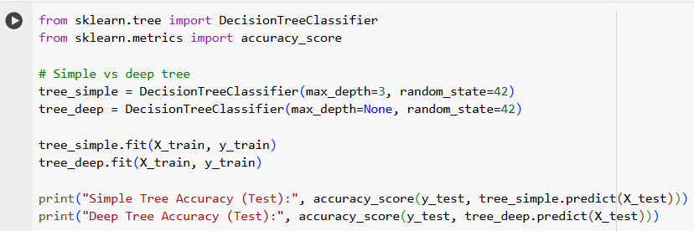
Example 2 – Overfitting Check (Decision Tree)

Slide 11
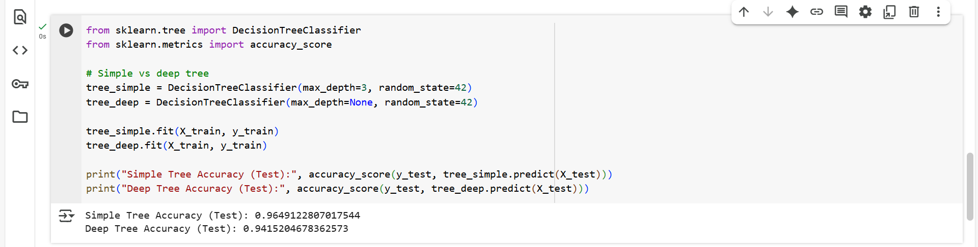
Example 2 – Result Analysis

Slide 12
Example 2 – Student Key Takeaways
Deep tree may overfit training data but perform worse on test data.
Real-world: Need balance (bias-variance trade-off).

Slide 13
Activity 3: Compare Train vs Test Accuracy
Task:
Modify the code to calculate both training and test accuracy for simple and deep trees.
Print results in a clear format.
Hint:
print("Simple Tree Accuracy (Train):", accuracy_score(y_train, tree_simple.predict(X_train)))
print("Deep Tree Accuracy (Train):", accuracy_score(y_train, tree_deep.predict(X_train)))
Student Questions:
Which model shows signs of overfitting?
Why does the deep tree perform better on training but worse on test data?

Slide 14
Activity 4: Use ROC Curve & AUC Instead of Accuracy
Task:
Extend the code to plot ROC curves and calculate AUC for both simple and deep trees.
Compare which model is more reliable based on AUC, not just accuracy.
Hint: Use predict_proba(X_test)[:,1] like in Example 1.
print("Simple Tree Accuracy (Train):", accuracy_score(y_train, tree_simple.predict(X_train)))
print("Deep Tree Accuracy (Train):", accuracy_score(y_train, tree_deep.predict(X_train)))
Student Questions:
Does the deep tree still look better when using AUC instead of accuracy?
Why is AUC sometimes a more useful metric than accuracy?

Slide 15
Simple Discussion Questions for Week 7
Q1. Why is accuracy not always enough to judge a model?
Accuracy only tells us the percentage of correct predictions. But in cases like medical diagnosis, even a few false negatives (missing a cancer case) are very dangerous. So, accuracy alone can hide serious problems.
Q2. What does the confusion matrix reveal that accuracy does not?
The confusion matrix shows exactly how many mistakes the model made:
False Positives (wrongly predicting cancer when there is none).
False Negatives (missing cancer when it is present). This detail is hidden if we only look at accuracy.

Slide 16
Simple Discussion Questions for Week 7
Q3. How can ROC/AUC help in a medical diagnosis setting?
ROC/AUC tells us how good the model is at separating sick vs. healthy patients across all thresholds. In medicine, we want very high sensitivity (catching all sick patients) even if it means a few extra false alarms.
Q4. What happens when a model is too simple vs. too complex?
Too simple → It underfits, misses patterns, gives poor predictions. Example: using only one rule to detect cancer.
Too complex → It overfits, memorises the training data but fails on new patients. Example: a giant tree that matches training perfectly but is useless in practice. Good models balance simplicity and generalisation.

Slide 17
Suggested Titles for Slides
Slide 1: Model Evaluation – Beyond Accuracy
Slide 2: Overfitting vs Generalization
Slide 3 (optional): Business Impact Example

Slide 18
Thank You
Need Help with coding? Send an email or ask during the tutorial session.
FKeivanian@my.holmes.edu.au

